Slide 1

Smart Blockchain Network driven by GANs framework for AML and Fraud Detection.

Slide 2

Team – The Zip Tomcat
SHARDA UNIVERSITY
B. TECH 2ND YEAR
Subhasmita Swain

Slide 3



What Motivated Us ?
Increasing Financial Fraud Percentage
Hefty Losses Incurred to citizens
No better preventive solution available.
Using Tech to transform and ease the daily lives of citizens.

Slide 4
Brief about the Project Idea and Motivation.
Creating a Safe Network for Transactions:
Establishing a Blockchain Network (distributed ledger based system) which would be having a central hub and local nodes distributed (nodes here are referred to the financial institutions). A smart contract will be developed with a cryptographic key-value pair subject to only the transaction party and receiver party. The whole process of secure transaction and information of exchange will be contained in an encrypted block.
Deploying a Machine Learning model in the Blockchain for Anti Money Laundering(AML) detection:
The Blockchain Network established will use a Machine Learning model driven by Generative Adversarial Networks framework based on semi-supervised learning of sparse auto-encoders for the detection of fraud, suspicious activities automatically over the network.

Slide 5



Tech Stack and Algorithm.
For Prototype we are using :
IBM Blockchain Extension on VS Code,
Hyperledger Fabric for Smart Contract Initialization,
JavaScript, Solidity, Python, Node.js
Ethereum Virtual Machine(For final system development), Docker, Open SSL
Algorithm :
Semi-Supervised GANs (Sparse Auto-encoders)
YOUR BUSINESS NAME

Slide 6

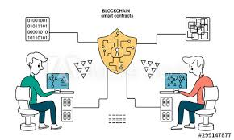
Establishing a Blockchain Network and smart contracts.
For a working prototype we have used the IBM Blockchain VS Code Extension for creating a smart contract over the Hyper Ledger Fabric Environment and generating key-value cryptographic pairs.
Each pair is unique for a particular party and an encrypted block is created for storing all the financial information, transaction details, identity etc. This encrypted block is only accessible to the network officers in charge of the system through a hash-code which is impossible for any one outside if the network to retrieve.
Since Blockchain contains a digital log of transactions, details of a particular Party’s activity can be monitored and flagged if suspicious through the anti fraud detection machine learning model working in the background.
PROJECT BASED LEARNING

Slide 7

Security Authentication
Each Financial Organization which would be connected over this network will serve as a node within the private permissioned blockchain network and would use network directory and smart contracts to record transactions on blockchain.
Every computational process and information storage will be hosted on cloud thereby making it cost effective for larger databases to be stored and accessed easily which was a hassle with paper based documentation and information storage.
PROJECT BASED LEARNING

Slide 8

What benefits are associated?
Every Transactional and financial details are stored in a blockchain hosted over cloud which improves the KYC process and speeds up the suspicious activity reporting in real time.
Every node (financial institution) on the will have direct access to all the information related to a account through a single hash-code.
The encrypted block is unique to the cryptographic key associated which in turn enables a two-factor authetication security, making it impossible for hackers to breach and access financial details.
YOUR BUSINESS NAME

Slide 9


Machine Learning Model for detection of fraud.
Various machine Learning models have been proposed for the detection and prevention of money Laundering however most of them have somehow failed to meet the expectations.
Based on a recent research paper our Blockchain Security system will be backed up by a Generative Adversarial Framework (GANs) based on semi-supervised learning of sparse auto-encoders for efficient and faster detection of suspicious activities and fake accounts in real-time.
This learning model will be continuously learning through real life cases which the model can access easily through an encoded API as everything is sitting on cloud and detect new patters of unusual behaviour making it very efficient and futuristic for Financial Theft Prevention.

Slide 10
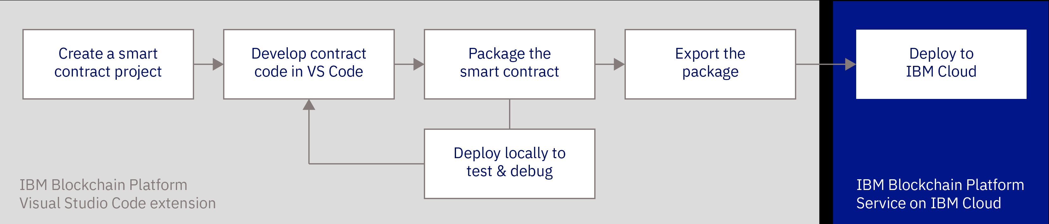
Smart Contract Development Workflow

Slide 11
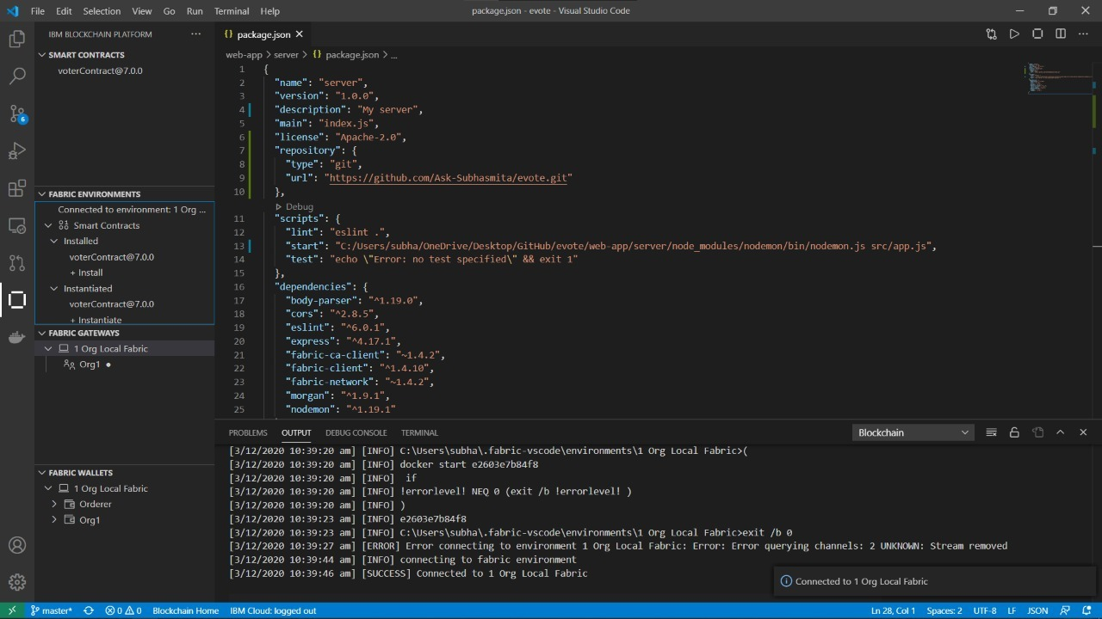
At System Working
Connecting the Local fabric network to initiate smart contact

Slide 12
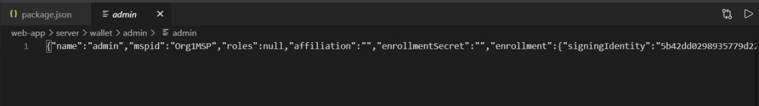
Admin Pass Key for access to the system only by network officers.

Slide 13
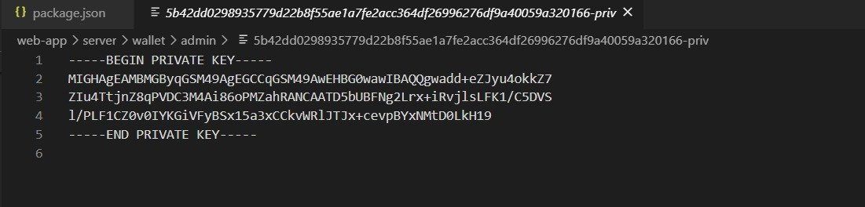
Private key binding that ensures key pair encodings and secure the newly added account for a registered Party.

Slide 14
Thank You.

